Slide 1
Office 365 development
Speaker name

Slide 2
SharePoint Remote Event Receivers

Slide 3
Agenda
Motivation
Remote Event Receiver Architecture
Creating Remote Event Receivers
Add-in Lifecycle Events
Debugging Remote Event Receivers

Slide 5
1
Motivation

Slide 6
SharePoint add-in building blocks
SharePoint add-ins
aspx
js
C#
Databases
png
CSS
master
Web Services
REST
SharePoint
CSOM
SharePoint API
Service Applications
List and libraries
Managed metadata
Search service
Workflow Service
BCS

Slide 7
Why Use Remote Event Receivers?
Respond to user actions and modifications to content
Add validation logic for columns on list items
Cleanup and format content as it is entered by users
Calculate and store aggregated values
Initialize host web with new lists during add-in installation

Slide 8
2
Remote Event Receiver Architecture

Slide 9
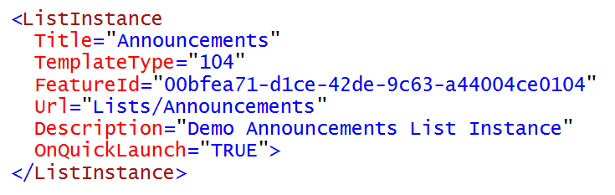
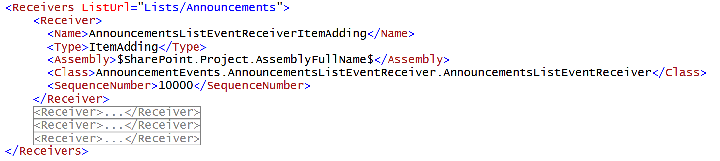
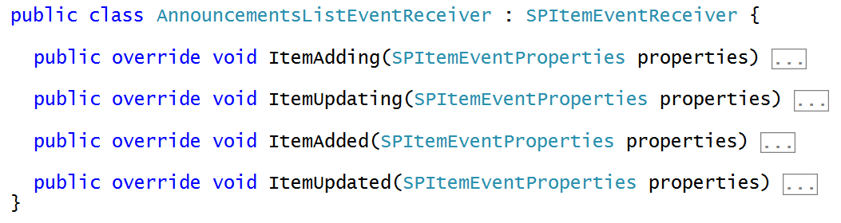
Review of Classic Server-side Events
You must have a target object which supports events
You must register for event handlers by referencing event receiver class
Event receiver class deployed by SharePoint solution in in .NET assembly

Slide 10
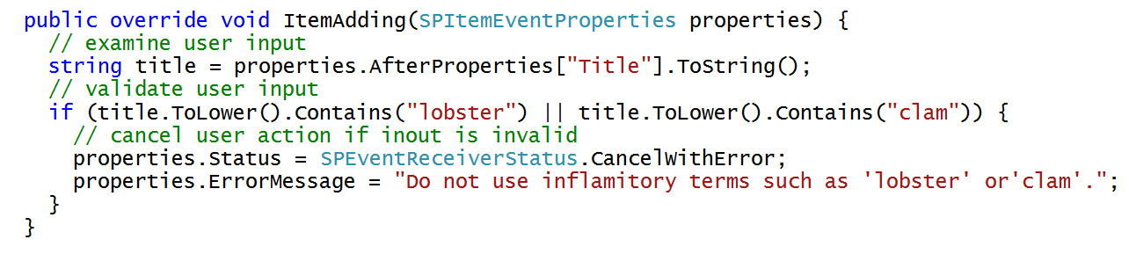
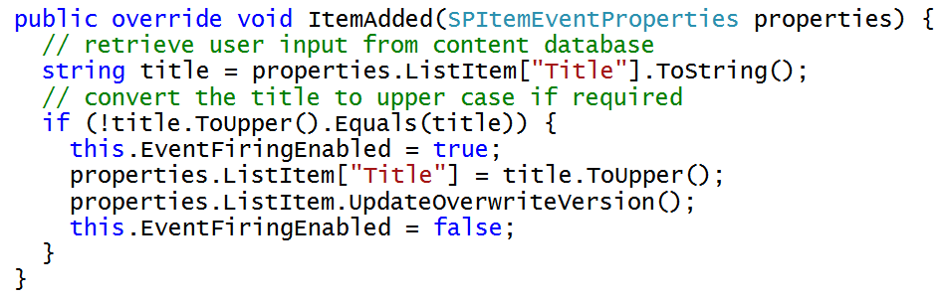
Programming Classic Server-side Events

Slide 11
DEMO
Nostalgic tour of classic Server-side Events

Slide 12
Event Handling Support in SharePoint 2013/6
Classic server-side events for SharePoint solutions
Supported as early as SharePoint 2003
Based on ‘before’ events and ‘after’ events
Event handlers implemented using event receiver class in C#
Event handler assembly loads into SharePoint worker process
New remote event infrastructure introduced for add-in model
Event handler code runs in remote web not in SharePoint host
SharePoint calls web service in remote web to trigger event
Set of supported remote events is subset of server-side events
Remote “before” events implemented as two-way events
Remote after events implemented as one-way events

Slide 13
Supported Remote Events
Site
Create
Move
Delete
Create
Delete
List Schema
Create
List Item
Create
Update
Delete
Move
CheckIn
Attachment Added
File Moved
Add-in
Install
Uninstall
Update
Delete
UnCheckIn
CheckOut
Attachment Removed
File Converted
List
Update
Notes:
The goal is to make the remote event receivers equivalent to the standard event receivers in SharePoint.
In cases where latency is high, remote synchronous events could cause significant delays in the operations that the event is responding to. Synchronous events are available today, though, and they’re important, especially for complex data validation rules.

Slide 14
Remote “Before” Events
Remote before events modeled as two-way events
Execution flow goes to remote web and then back to SharePoint
Client is blocked while event processing occurs in remote web
Sample execution flow for two-way event
Client attempts action which triggers an event (e.g. update item)
SharePoint host calls to web service in remote web
SharePoint host blocks until call returns from remote web the key point is that two-way events block the SharePoint host and delay response back to user
SharePoint host commits action and returns to Client
Two Way Event (aka before event)
Client
SharePoint Host
Remote Web
1
2
4
3

Slide 15
Remote “After” Events
Remote after events modeled as one-way events
Execution flow goes to remote web but does not return
Unlike before events, after events do not block client response
Sample execution flow for one-way event
Client attempts action which triggers an event (e.g. update item)
SharePoint host commits action and returns to Client
SharePoint host executes one-way WCF call on remote web the key point is that one-way events do not block the SharePoint host nor delay response back to user
One Way Event (aka after event)
Client
SharePoint Host
Remote Web
1
3
2

Slide 16
3
Creating Remote Event Receivers

Slide 17
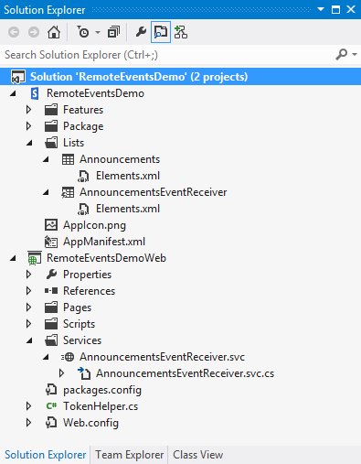
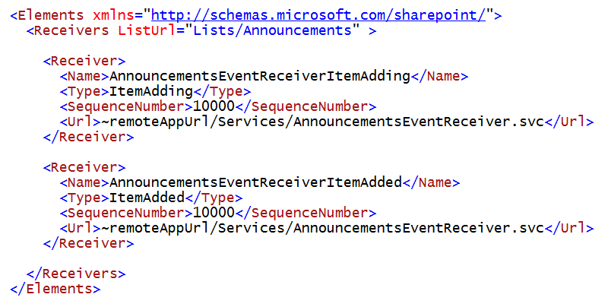
Registering Remote Events Receivers
Event receivers must be registered with SharePoint host
Registration can be declaratively with XML for events occurring in app web
Registration for events occurring in host web requires write procedural code

Slide 18
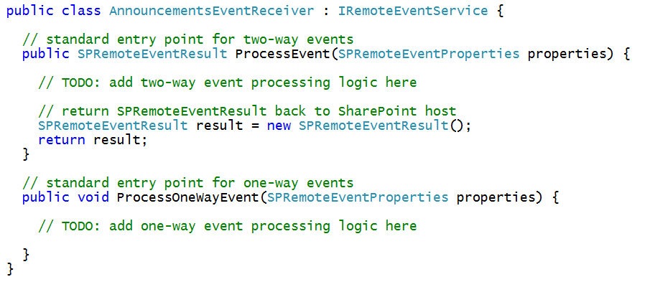
The Remote Event Receiver Entry Point
Remote event receiver implemented with .svc file
Event receiver code written as C# code code-behind .svc file
Event receiver is class that implements IRemoteEventService
ProcessEvent method executes when two-way event is triggered
ProcessOneWayEvent method executes when one-way event is triggered

Slide 19
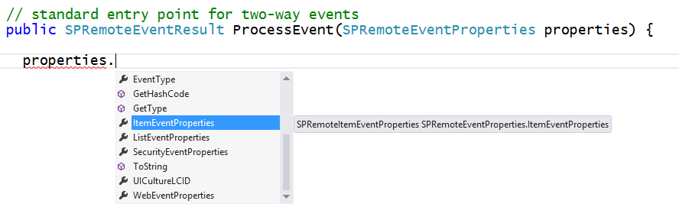
SPRemoteEventProperties
SPRemoteEventProperties passed as parameter
Provides you with contextual information about the current event
Make it possible to determine event type and event target object
Makes it possible to read user input to perform validation

Slide 20
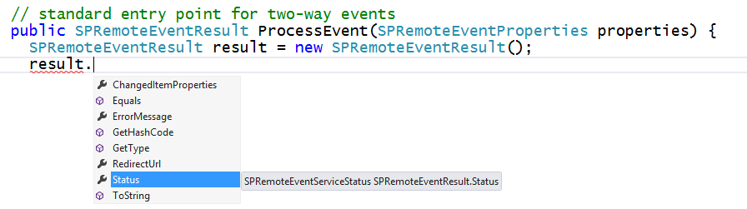
SPRemoteEventResult
ProcessEvent must return SPRemoteEventResult object
Makes it possible to cancel user action when user input is invalid
Makes it possible to update user input when processing a before events

Slide 21
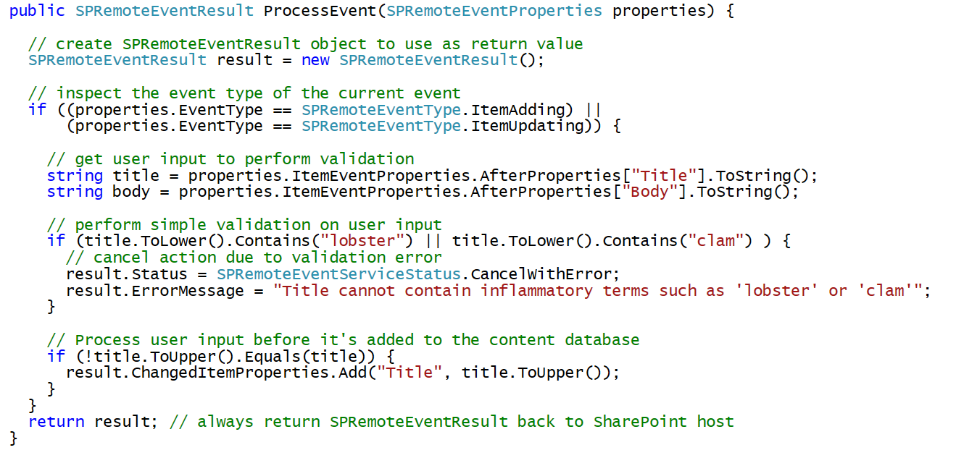
Example Before Event with a List Item

Slide 22
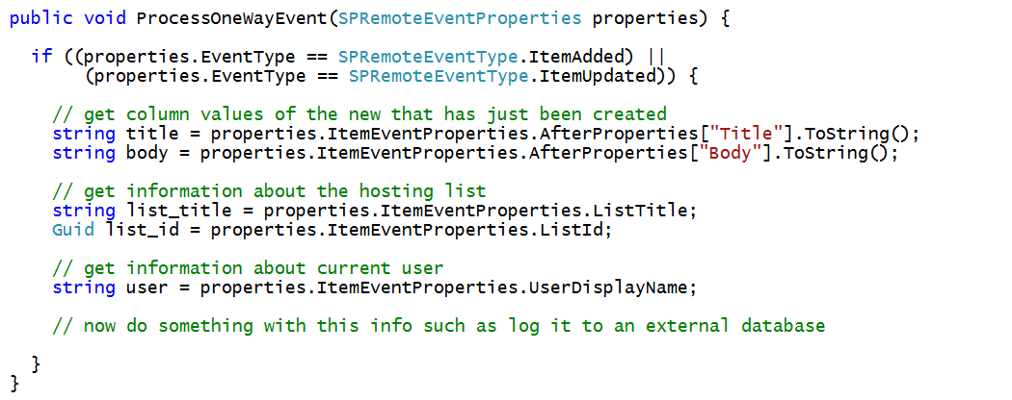
Example After Event with a List Item

Slide 23
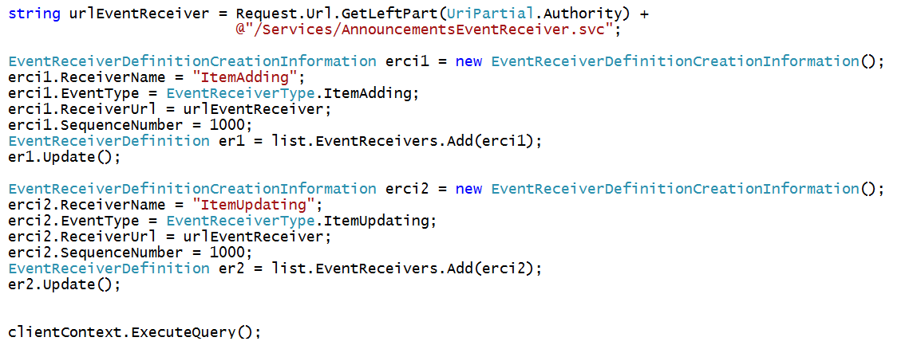
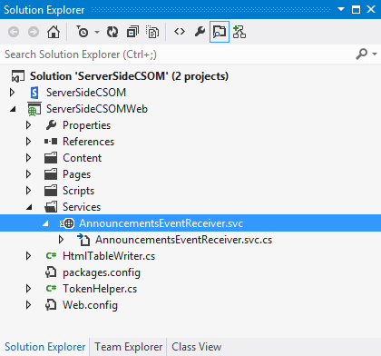
Registering Remote Event Receivers using CSOM
Remote Event Receivers require registration
Declarative registration only possible in app web
Registration in host web requires CSOM code
Remote web must supply the required entry point (e.g. MyEventReceiver.svc)

Slide 24
Demo
3 Creating Remote Event Receivers
Validating user input using a Remote Event Receiver

Slide 25
4
Add-in Lifecycle Events

Slide 26
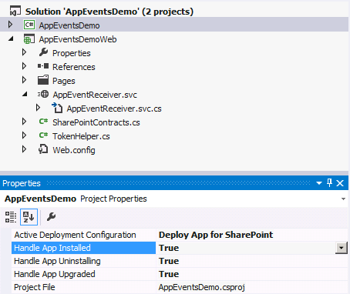
App Lifecycle Events
SharePoint app models support app events
App events for installation, upgrade and uninstall
Added to app project using property sheet
Implemented as a remote event receiver
Notes:
The installation, upgrade and uninstallation of an app raises events that developers can trap. These are surfaced as remote event receivers where the app calls out to a well known endpoint where the developer can do something upon these events.

Slide 27
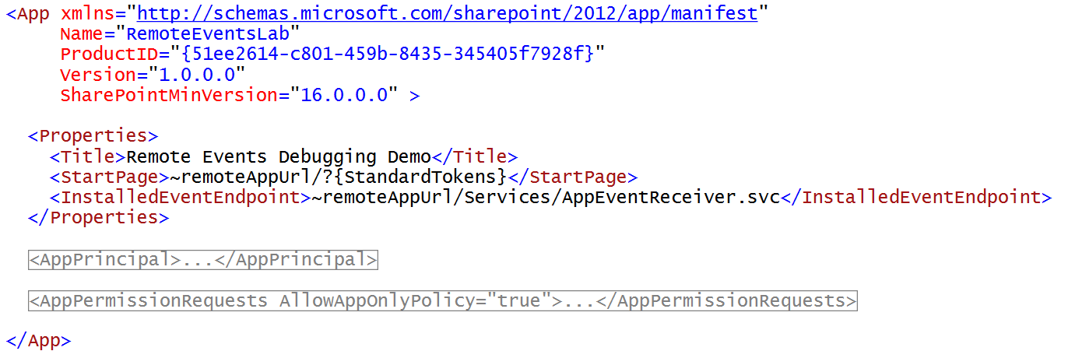
App Lifecycle Event Registration
Declaratively register in AppManifest.xml
Notes:
Remote Event Receivers can also be set up for Installed, Uninstalling, and Upgrading events in the App lifecycle.
To handle a SharePoint app event, set its event value to True in Visual Studio. The default value for the events is False. When you set the value of an app event to True, Visual Studio creates an app event receiver. To disable an app event receiver, set its value to False

Slide 28
Demo
4 Creating, Updating & Deleting Data with REST Services
Creating an AppInstalled Event handler

Slide 29
5
Debugging Remote Events

Slide 30
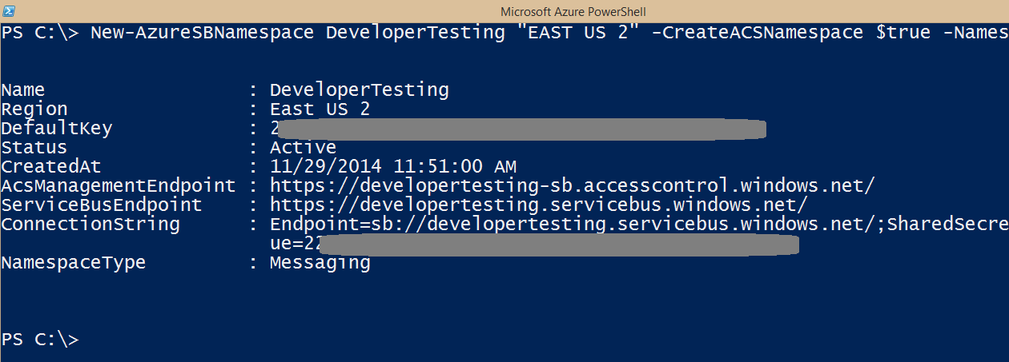
Debugging Event in Office 365
Addresses with http://localhost do not work!
You must use Azure Service Bus Namespace

Slide 31
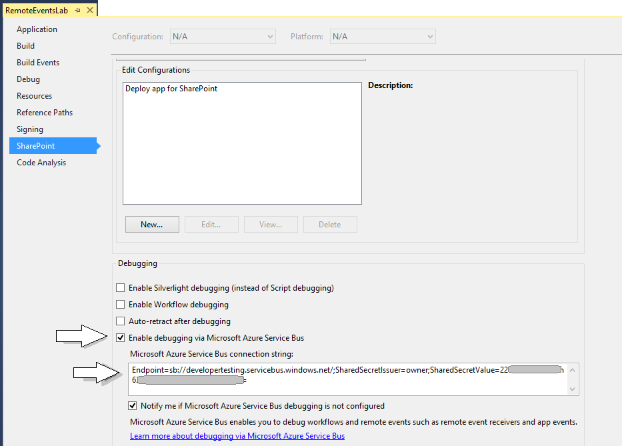
Visual Studio Debugging Support

Slide 32
Demo
5 Debugging Remote Events
Creating an Azure Service bus namespace for debugging

Slide 33
Summary
Motivation
Remote Event Receiver Architecture
Creating Remote Event Receivers
Add-in Lifecycle Events
Debugging Remote Event Receivers

Slide 34
Further reading…
SharePoint Code Samples
SharePoint Training videos and hands on labs
SharePoint documentation
SharePoint Patterns and Practices (PnP)

Slide 35
Engage

